Slide 1
Project Presentation of CO-OP Project at Industry (Module-2) (22CS421)
On
Machine-Learning-Based Intrusion Detection System: A Comparative Study Using Decision Tree and Ensemble Classifiers on NSL-KDD
Rudraneel Pal Banik
2210992193
Supervised By
Dr. Isha Kansal
Associate Professor
Department of Computer Science and Engineering,
Chitkara University, Punjab

Slide 2
Contents
Introduction & Problem Statement
Dataset: NSL-KDD
Methodology
Results: Binary Classification
Results: Multi-Class & Feature Importance
Discussion
Conclusion & Future Work
2

Slide 3
Introduction
Introduction
Cybersecurity threats have increased significantly with the rapid growth of cloud computing, IoT devices, and large-scale networked systems. Traditional signature-based Intrusion Detection Systems (IDS) are effective only against known attack patterns and often fail to detect zero-day or previously unseen attacks. Machine Learning-based IDS provide a more adaptive solution by learning behavioral patterns from network traffic data and identifying malicious activity automatically.
Research Problem
Although machine learning has improved intrusion detection, many IDS models still struggle to generalize to unseen attack types and highly imbalanced attack categories such as R2L and U2R. Existing studies also frequently report inflated performance by evaluating models only on training distributions. This project addresses these issues through a reproducible comparative study of Decision Tree, Random Forest, Naive Bayes, and Linear SVM classifiers on the NSL-KDD benchmark dataset.
3

Slide 4
Dataset: NSL-KDD
NSL-KDD refines KDD'99 by removing ~78% redundant records — eliminates classifier bias toward high-frequency attacks
125,973 training records (KDDTrain+) | 22,544 test records (KDDTest+)
41 connection-level features — protocol, duration, byte counts, flags
5 Traffic Categories
Normal — legitimate network connections
DoS — Denial of Service (SYN flood, UDP flood)
Probe — network scanning and mapping
R2L — Remote to Local, unauthorized remote access
U2R — User to Root, privilege escalation
KDDTest+ contains 17 novel attack sub-types not seen during training — tests real-world generalisation
Limitation: does not reflect modern encrypted traffic or advanced persistent threats (APTs)
4

Slide 5
Methodology
Preprocessing
One-hot encoding: 3 categorical features expanded 41 to 122 dimensions
Min-Max normalisation: all features scaled to [0, 1]
4 Classifiers trained under identical conditions
Decision Tree — entropy criterion, max_depth=20, min_samples_split=5
Random Forest — 100 trees, same DT params, majority-vote ensemble
Naive Bayes — Gaussian NB, assumes feature independence
Linear SVM — C=1.0, One-vs-Rest multi-class strategy
Evaluation Protocol
Train on KDDTrain+, evaluate on held-out KDDTest+ (with 17 unseen attack sub-types)
5-fold stratified cross-validation on training set for stability
Metrics: Accuracy, Precision, Recall, F1-Score | McNemar's test for statistical significance
5

Slide 6
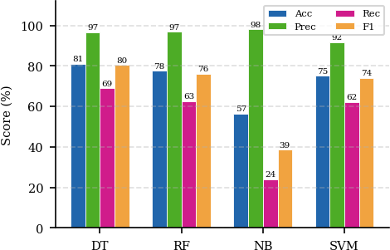
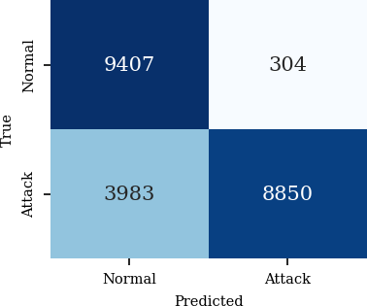
Results: Binary Classification
5-fold CV (KDDTrain+):
DT 99.72% | RF 99.68% | SVM 98.91% | NB 85.73%
Held-out KDDTest+:
DT best trade-off: Acc 80.98%, Prec 96.68%, Rec 68.96%, F1 80.5%, train 0.79s
RF: marginal precision gain, significantly higher compute cost
NB: 98% precision BUT 75.9% false negative rate — unsuitable as standalone detector
Fig 1. Accuracy, Precision, Recall, F1 across all classifiers
Fig 2. DT Binary Confusion Matrix
6

Slide 7
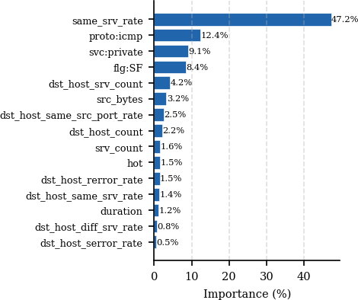
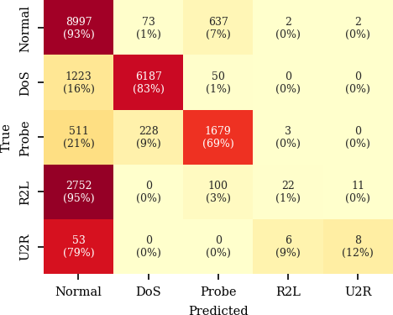
Results: Multi-Class & Feature Importance
Fig 3. Multi-Class Confusion Matrix (5 categories)
Fig 4. Top 15 Feature Importances (Information Gain)
DoS: 83% recall | Probe: 69% recall
R2L: ~1% recall — lost in normal traffic
U2R: ~12% recall — too few training examples
same_srv_rate dominates at 47.2%
DoS flooding maximises same-service connections
proto:icmp (12.4%) — ICMP strongly linked to probe/DoS attacks
7

Slide 8
Discussion
Finding 1 — Decision Tree is the optimal choice for IDS deployment
Best F1 (80.5%) at lowest training cost (0.79s); recommended for real-time network monitoring
Finding 2 — The CV vs. held-out gap is the critical insight of this study
DT CV accuracy 99.72% vs. KDDTest+ accuracy 80.98%
Caused entirely by 17 novel attack sub-types in test set — never seen during training
Reporting only CV accuracy significantly overstates real-world IDS performance
Finding 3 — Minority class failure is universal across all 4 classifiers
R2L and U2R attacks consistently undetected — class imbalance + behavioural similarity to normal traffic
Standard supervised learning is insufficient; needs SMOTE or anomaly detection complement
8

Slide 9
Conclusion & Future Work
Key Takeaways
Decision Tree achieves best F1 (80.5%) — recommended for practical IDS deployment
Naive Bayes: unsuitable standalone — 75.9% false negative rate is unacceptable in a security context
Always evaluate on held-out data containing novel attack types; CV alone is misleading
R2L and U2R remain the unsolved challenge — standard supervised learning is not enough
Future Work
SMOTE oversampling + cost-sensitive learning to improve minority class recall
Deep learning (CNN, LSTM) for temporal and sequential attack pattern detection
Evaluation on modern datasets: CICIDS-2017, UNSW-NB15 with encrypted traffic
Hybrid system: DT for speed + dedicated anomaly detector for rare attack categories
9

Slide 10
Thank You
10

